Slide 1


PROPOSAL
WEB DESIGN

Slide 2


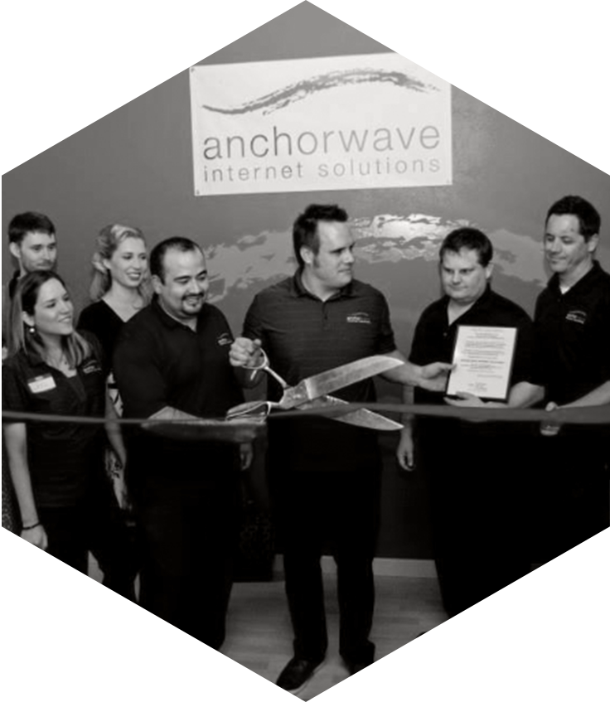

WHO IS ANCHOR WAVE?
HISTORY & FUTURE
FOUNDED
+DIGITAL MARKETING DEP.
10 YEARS, 20 ROCKSTARS
1300+ SITES LAUNCHED
2003
2008
2013
2018
Notes:
To give you a little information about Anchor Wave. We were founded in 2003. At that time we were only developing websites which was everyone’s primary focus at that time. After a few years many of our client’s starting asking, “now what”. Now that I’ve built this amazing site, how do I leverage it. So in 2008 our Digital Marketing Department was created. We now had all the pieces of the puzzle. Since then we have grown to 20 employees, built over 1,100 sites and managed hundreds of digital marketing campaigns.

Slide 3



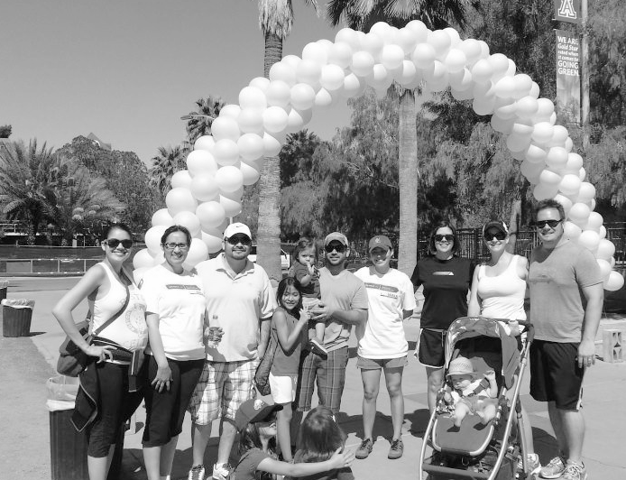


WHO IS ANCHOR WAVE?
COMMUNITY
& GIVING
VOLUNTEERS
PROJECT SUPPORTERS
SPONSORS
MEMBERS
Notes:
In our 14 years of business, Anchor Wave has strived to be a great corporate citizen. Our culture is built upon individuals who want to give back to this community that has given us so much. These are just a few examples of some of the groups we are involved with. We encourage our team members to become actively involved in non-profits that mean something to them and have had the pleasure of serving on boards and sponsoring many of these organizations.

Slide 4
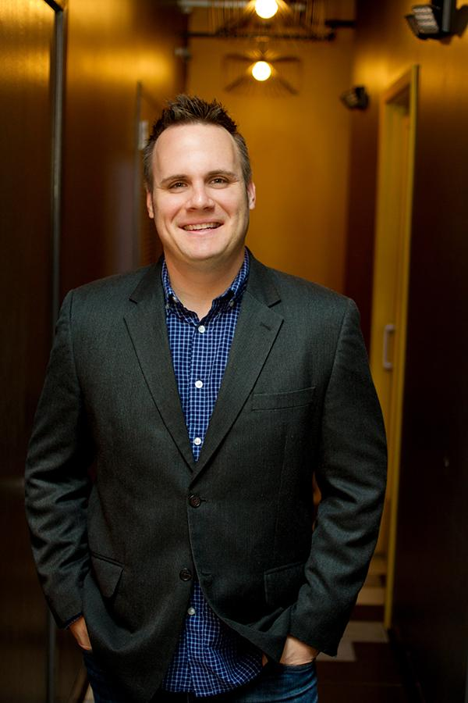
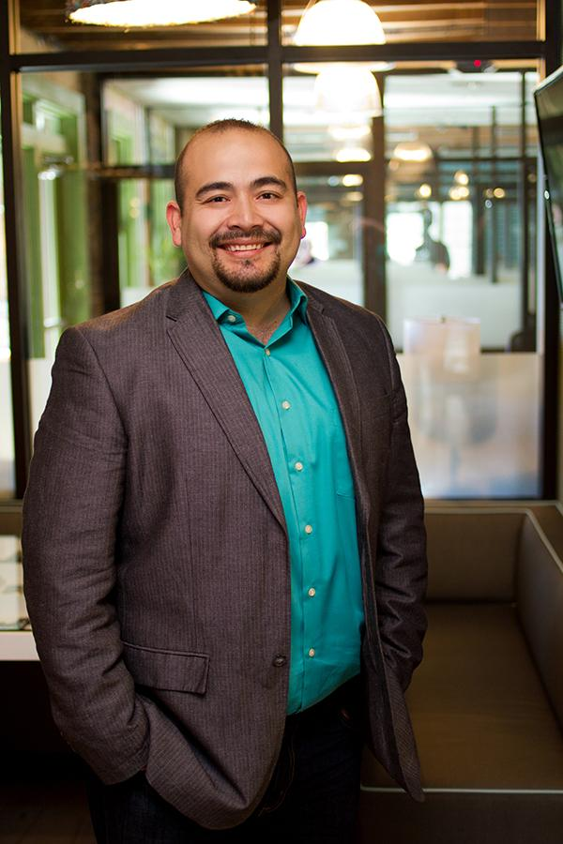

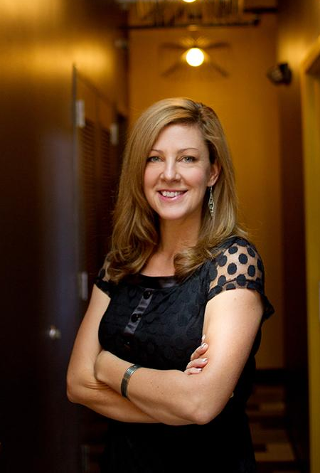
WHO IS ANCHOR WAVE?
LEADERSHIP
MIKE SCHMIDT
ANTHONY RIVERA
TREY WESSON
LILLY DARLING
CEO & FOUNDER
PRESIDENT
INTERNET MARKETING DIRECTOR
VICE PRESIDENT
Notes:
In our 14 years of business, Anchor Wave has strived to be a great corporate citizen. Our culture is built upon individuals who want to give back to this community that has given us so much. These are just a few examples of some of the groups we are involved with. We encourage our team members to become actively involved in non-profits that mean something to them and have had the pleasure of serving on boards and sponsoring many of these organizations.

Slide 5










WHO IS ANCHOR WAVE?
EXPERTS, ON YOUR TEAM
MARKETING
SPECIALISTS
TECHNICAL
SUPPORT
DIGITAL
MARKETERS
DESIGNERS
PROJECT
COORDINATORS
DEVELOPERS
COPYWRITER &
PHOTOGRAPHER
WEB STRATEGIST
Notes:
One of the things that makes Anchor Wave different is our ability to leverage a large team of specialists. Many other companies have smaller teams of 3-4 people. This means they have to wear a lot of hats that require very different skill sets. So you might have someone trying to be a designer and coder. While they may be good at one, chances are they are just ok at both.At Anchor Wave we believe in hiring people that are experts in one core area. The result of this is work that is better than any of us could do on our own.

Slide 6

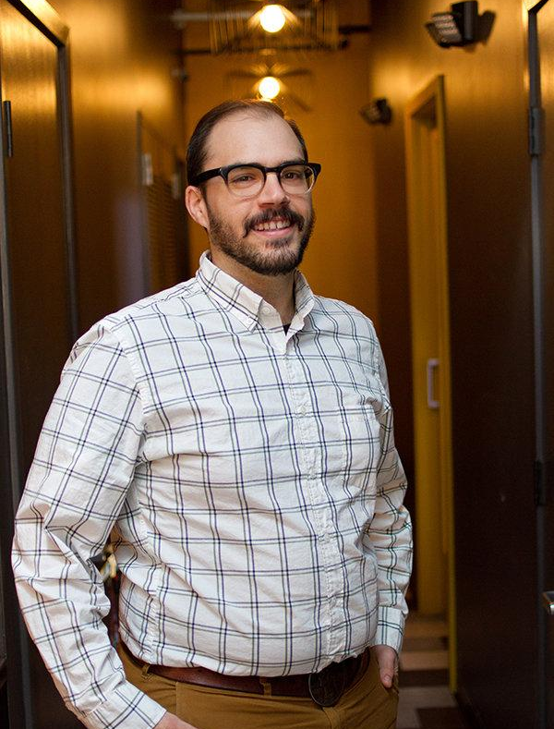


WHO IS ANCHOR WAVE?
sr. project coordinator
MEET YOUR
TEAM
Your Project Coordinator is your Guide
Experts in Defined Positions: coders, designers, digital marketing.
Commitment to Client Partnership.
Consultative Goal Setting Techniques aimed to ensure successful outcomes.
_
project coordinator
PROJECT COORDINATOR
SR. PROJECT COORDINATOR
VICE PRESIDENT
Notes:
The first step is a kickoff meeting. This is our opportunity to get everyone on the same page regarding your project. I’ll be in the meeting and I’ll also introduce you to your project coordinator who will be your primary point of contact during the entire project. During this meeting the project coordinator will be asking you a lot of questions. Some of the questions may be items I’ve covered with you, but I want them to hear it directly from you as sometimes things get lost in translation.
They’ll be asking you things like what your primary goal is for the website. Additionally, they’ll be asking if there are any secondary goals we should consider. This is important because we’ll share all of the goals with our team so they can make better decisions as they are working on the website. They also be asking things like who are the different audiences that will be visiting the site and what their needs are. This might includes prospects, existing clients, vendors, strategic partners etc. Keep in mind that you don’t have to have all the answers. We will help guide you through this process.

Slide 7

YOUR VISION.
We’ll help you get there...
Notes:
What I’m about to show you now is about your vision. I heard you were out to do XYZ, that’s important because ETC….
Where you are now and where you want to go.
“Multi family construction….you want to own that industry and also expand to commercial…The gap is the perception, and marketing strategy”
Higher resolution

Slide 8

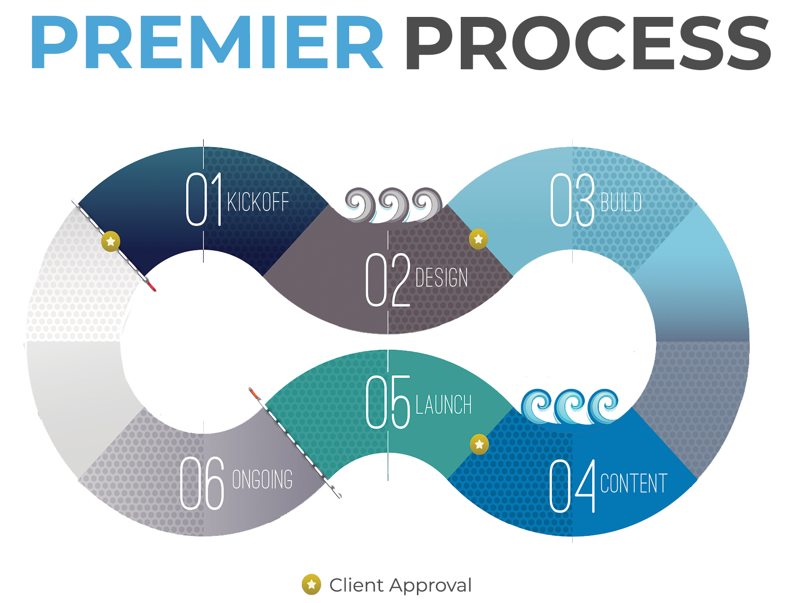

PREMIER
WEBSITE
Fully Custom
KICKOFF
DESIGN
BUILD
CONTENT
LAUNCH
DIGITAL
MARKETING
Notes:
This is a visual representation of our web design process. This may sound funny since we are a digital company, but this is based on a physical binder that we create at the beginning of a project. We create two binders, one for our project coordinator and one for you to follow along with the process. The process is broken out into 5 steps that I’ll walk you through now.

Slide 9



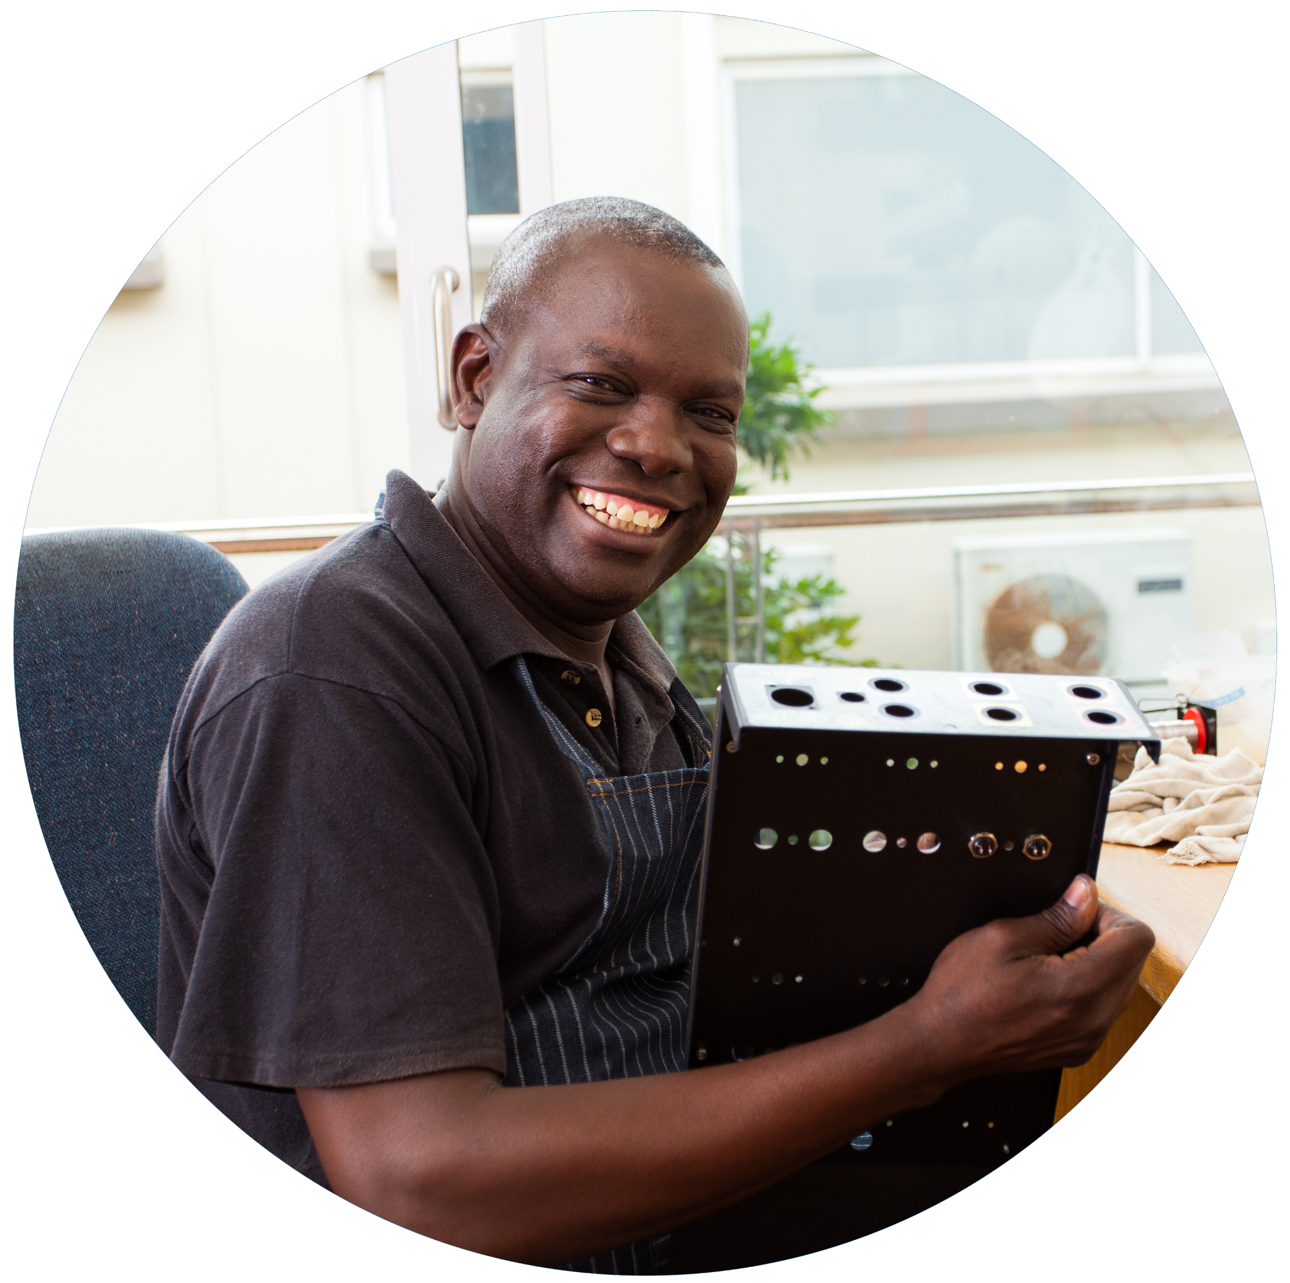

PERSONA DETAILS
DATA DRIVEN
Responds well to images and lists
KICKOFF
CUSTOMER
PERSONAS
LOOKING FOR RELEVANT EXPERIENCE
KICKOFF
DESIGN
GARY EDWARDS
Architect
BUILD
CONTENT
LAUNCH
DEFINED CHECKLISTS
STEP-BY-STEP PROCESS
BUYER PERSONAS
CONTENT TIPS
WEBSITE EDUCATION
DIGITAL
MARKETING
BINDER TOOLS
Notes:
A buyer persona is a semi-fictional representation of your ideal customer based on market research and real data about your existing customers. We will create at least three buyer personas. This exercise makes sure our marketing strategies communicate to your visitors and their specific goals.

Slide 10

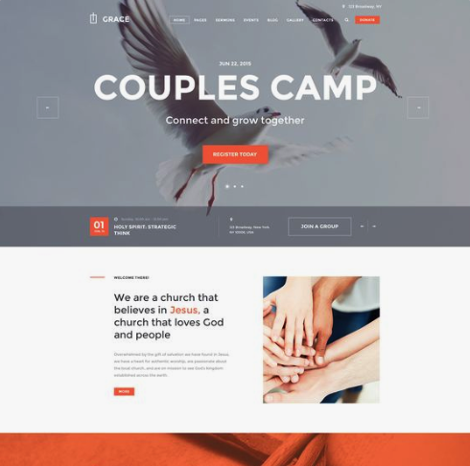

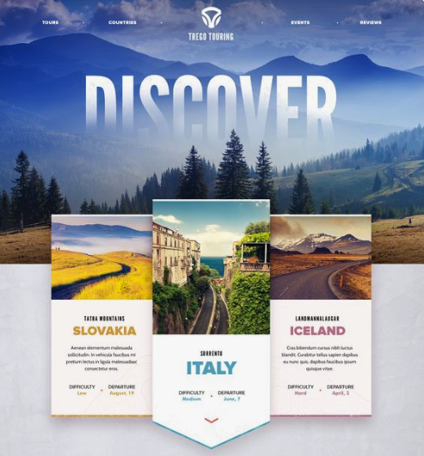
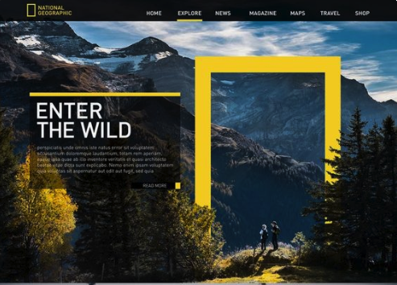
PREMIER
INDUSTRY ANALYSIS
MOOD:
DARK/LIGHT
STYLE:
MODERN/TRADITIONAL
CONTENT:
IMAGE HEAVY/TEXT-BASED
STYLE:
COLORFUL/CORPORATE
SELECTION:
20-30 EXAMPLES GATHERED SPECIFICALLY FOR YOU
WEBSITE
RESEARCH
KICKOFF
DESIGN
BUILD
CONTENT
LAUNCH
DIGITAL
MARKETING
Notes:
The next step is website research. We’ll go out and find 20-30 examples of other websites for you to review. Often times we look outside of Tucson because honestly there’s usually not a ton of great examples and we don’t want to show you a bunch of horrible sites to gain inspiration from. In fact, we’ll also include examples that aren’t even in your industry but have unique elements we want you to review. The goal of this step isn’t for you to see a site, say I want one like that. Its for us to hear your gut reaction when you see the site. Do you like it or not like it. Do you like the colors, specific elements. How you respond gives our designers all of the clues they need to design something matches your tastes in terms of design and layout.

Slide 11


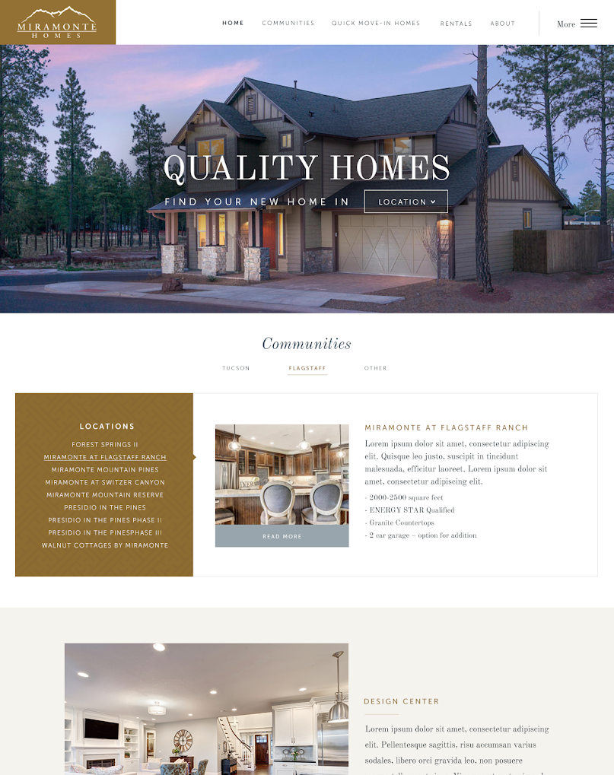
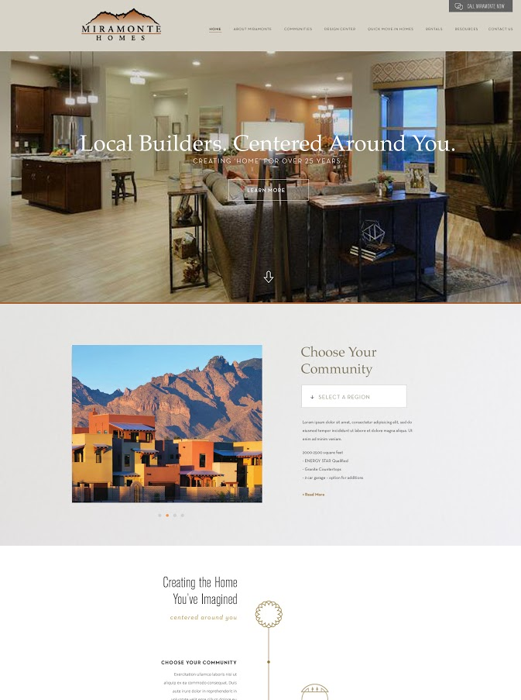
TWO DESIGNS
custom crafted by our skilled in-house designers
1
PREMIER
HOMEPAGE
DESIGN
KICKOFF
DESIGN
BUILD
CONTENT
2
LAUNCH
DIGITAL
MARKETING
Notes:
After the kickoff and website research meetings our project coordinator will create a web design spec that summarizes everything we’ve learned up to that point. She’ll hand it off to the designers and each will create an initial mockup of the homepage. This is probably my favorite part of the process because it’s the first chance you get to see what your site will look like. We like to have 2 designs because you’ll usually just gravitate to one of the designs presented. Sometimes you might like elements of both and we can try to merge the two together. Once we are settled in to what the homepage of your site looks like then we’ll start mocking up some of the interior pages.

Slide 12
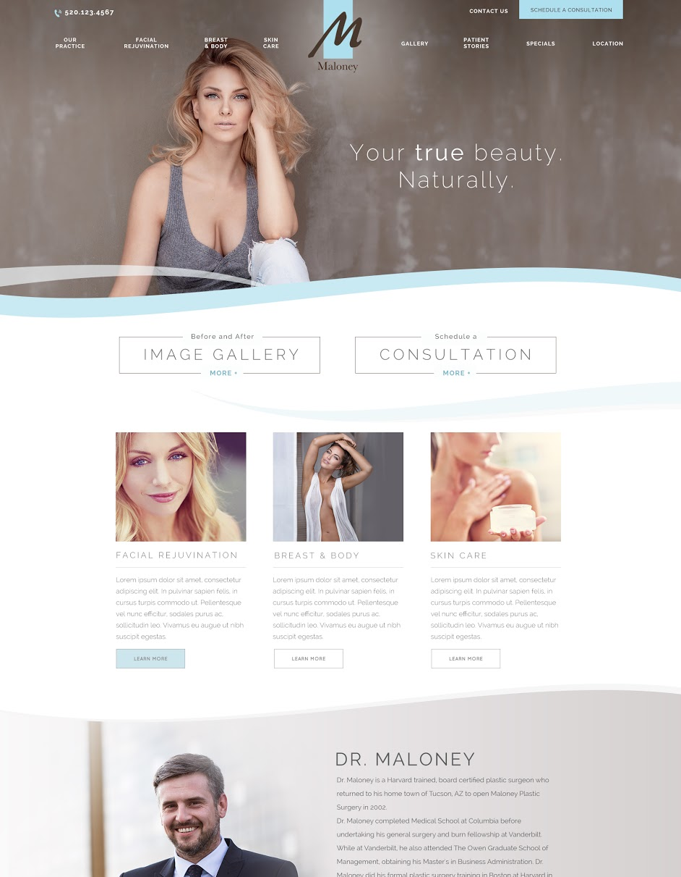
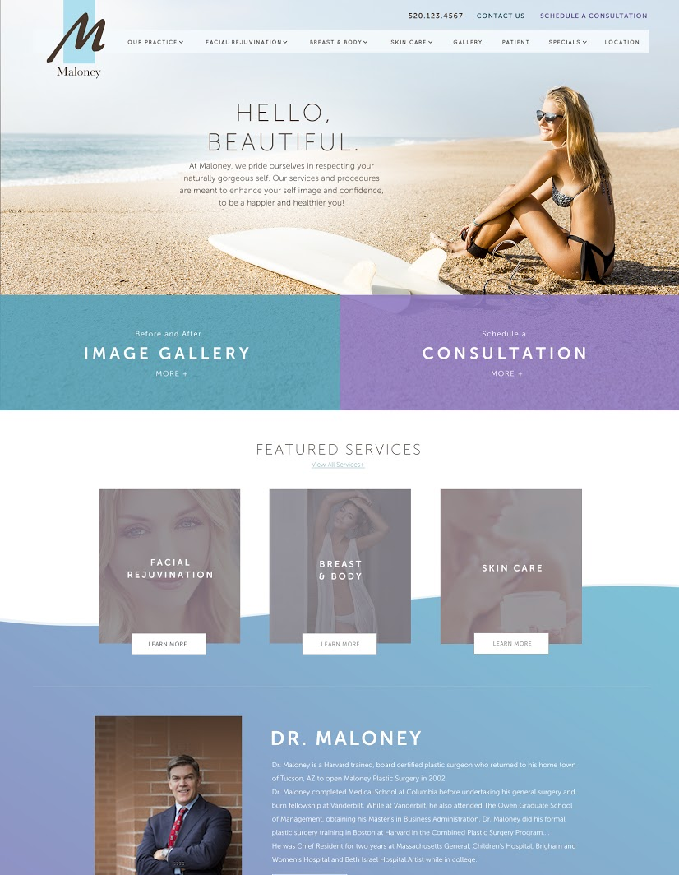
PREMIER DESIGN
Maloney Plastic Surgery
1
PREMIER
HOMEPAGE
DESIGN
KICKOFF
DESIGN
BUILD
CONTENT
2
LAUNCH
DIGITAL
MARKETING
Notes:
After the kickoff and website research meetings our project coordinator will create a web design spec that summarizes everything we’ve learned up to that point. She’ll hand it off to the designers and each will create an initial mockup of the homepage. This is probably my favorite part of the process because it’s the first chance you get to see what your site will look like. We like to have 2 designs because you’ll usually just gravitate to one of the designs presented. Sometimes you might like elements of both and we can try to merge the two together. Once we are settled in to what the homepage of your site looks like then we’ll start mocking up some of the interior pages.

Slide 13
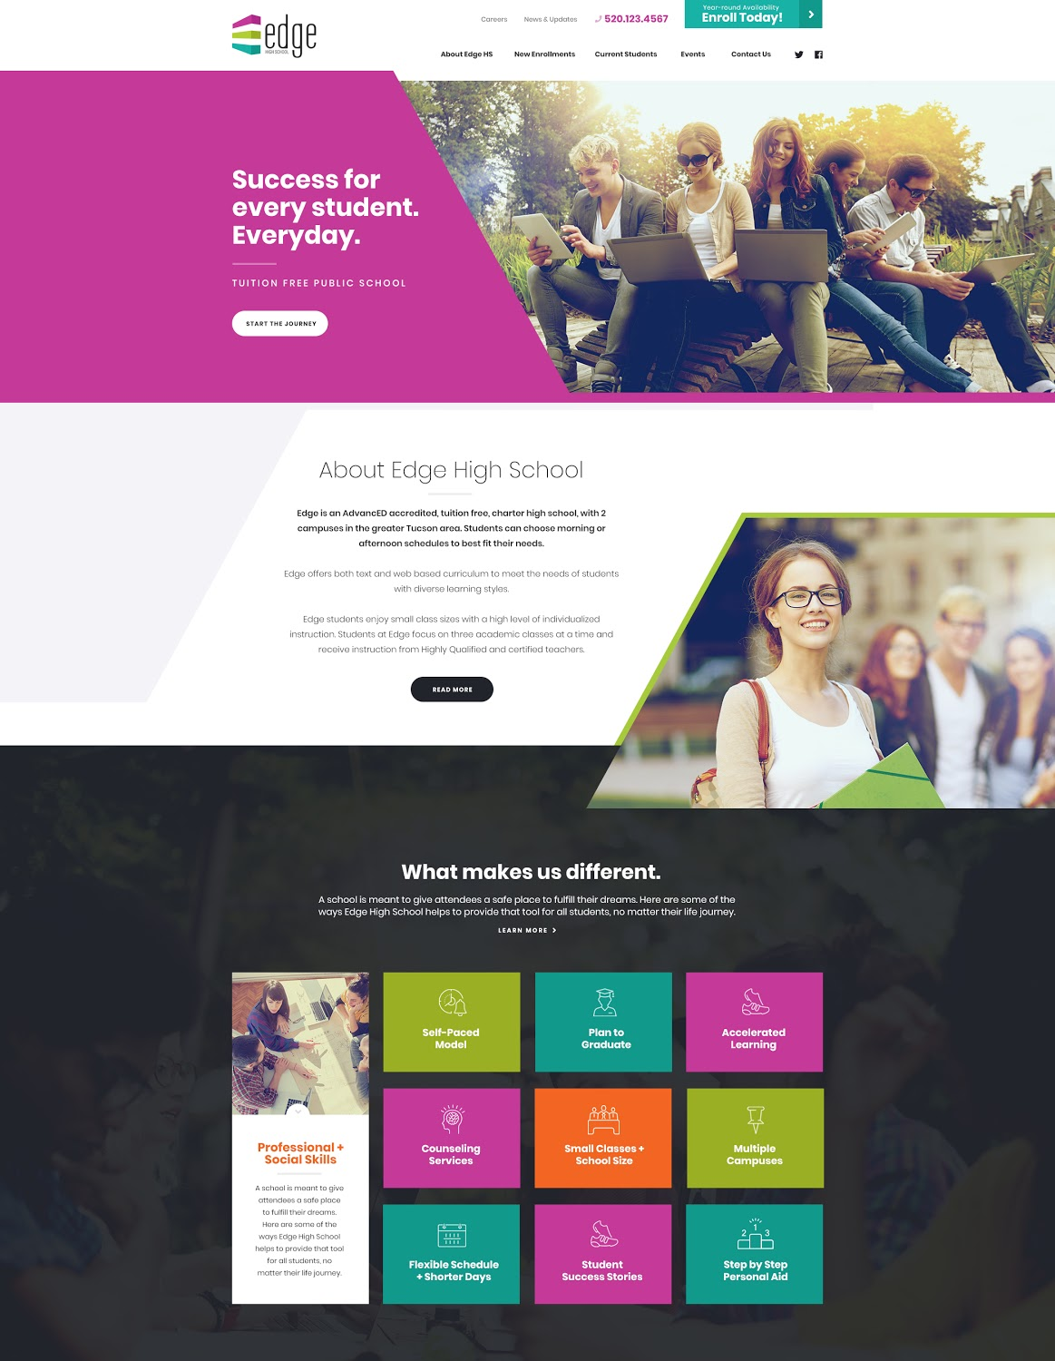
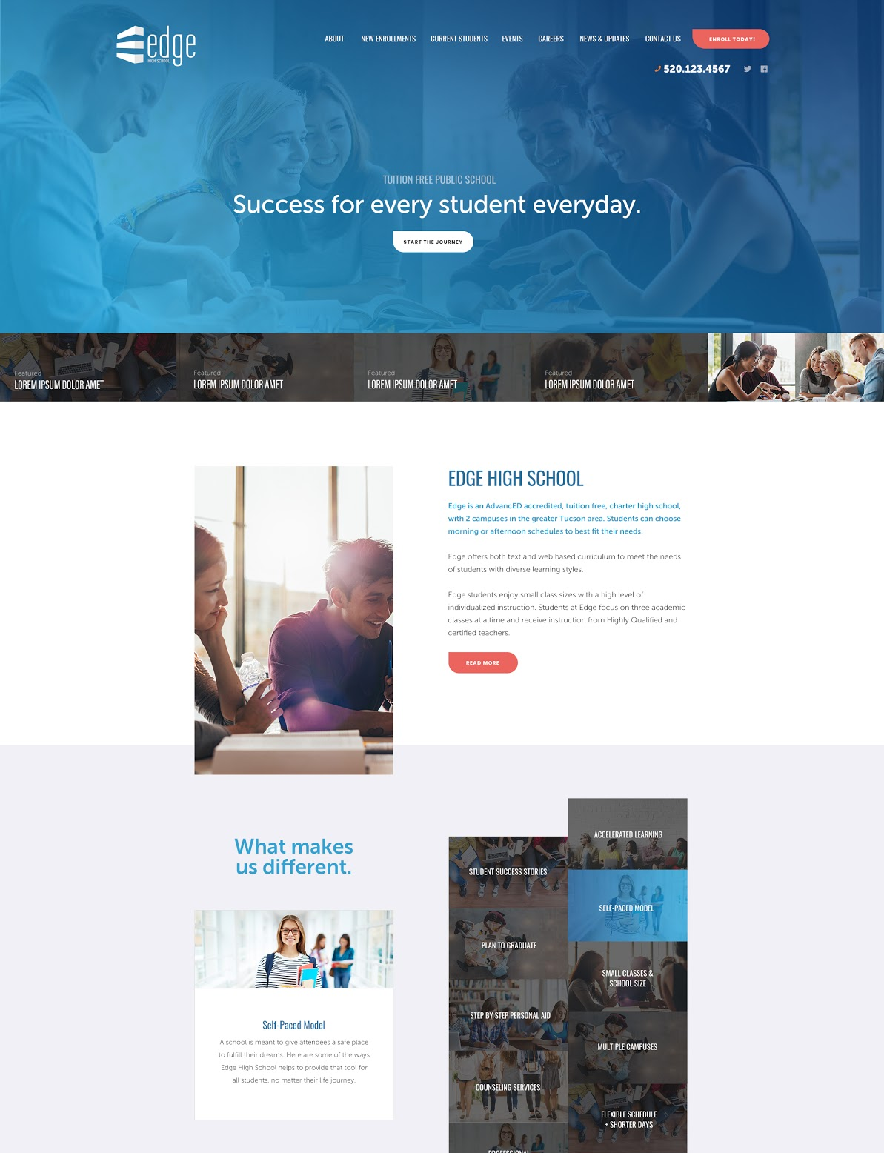
PREMIER DESIGN
Edge High School
1
PREMIER
HOMEPAGE
DESIGN
KICKOFF
DESIGN
BUILD
CONTENT
2
LAUNCH
DIGITAL
MARKETING

Slide 14
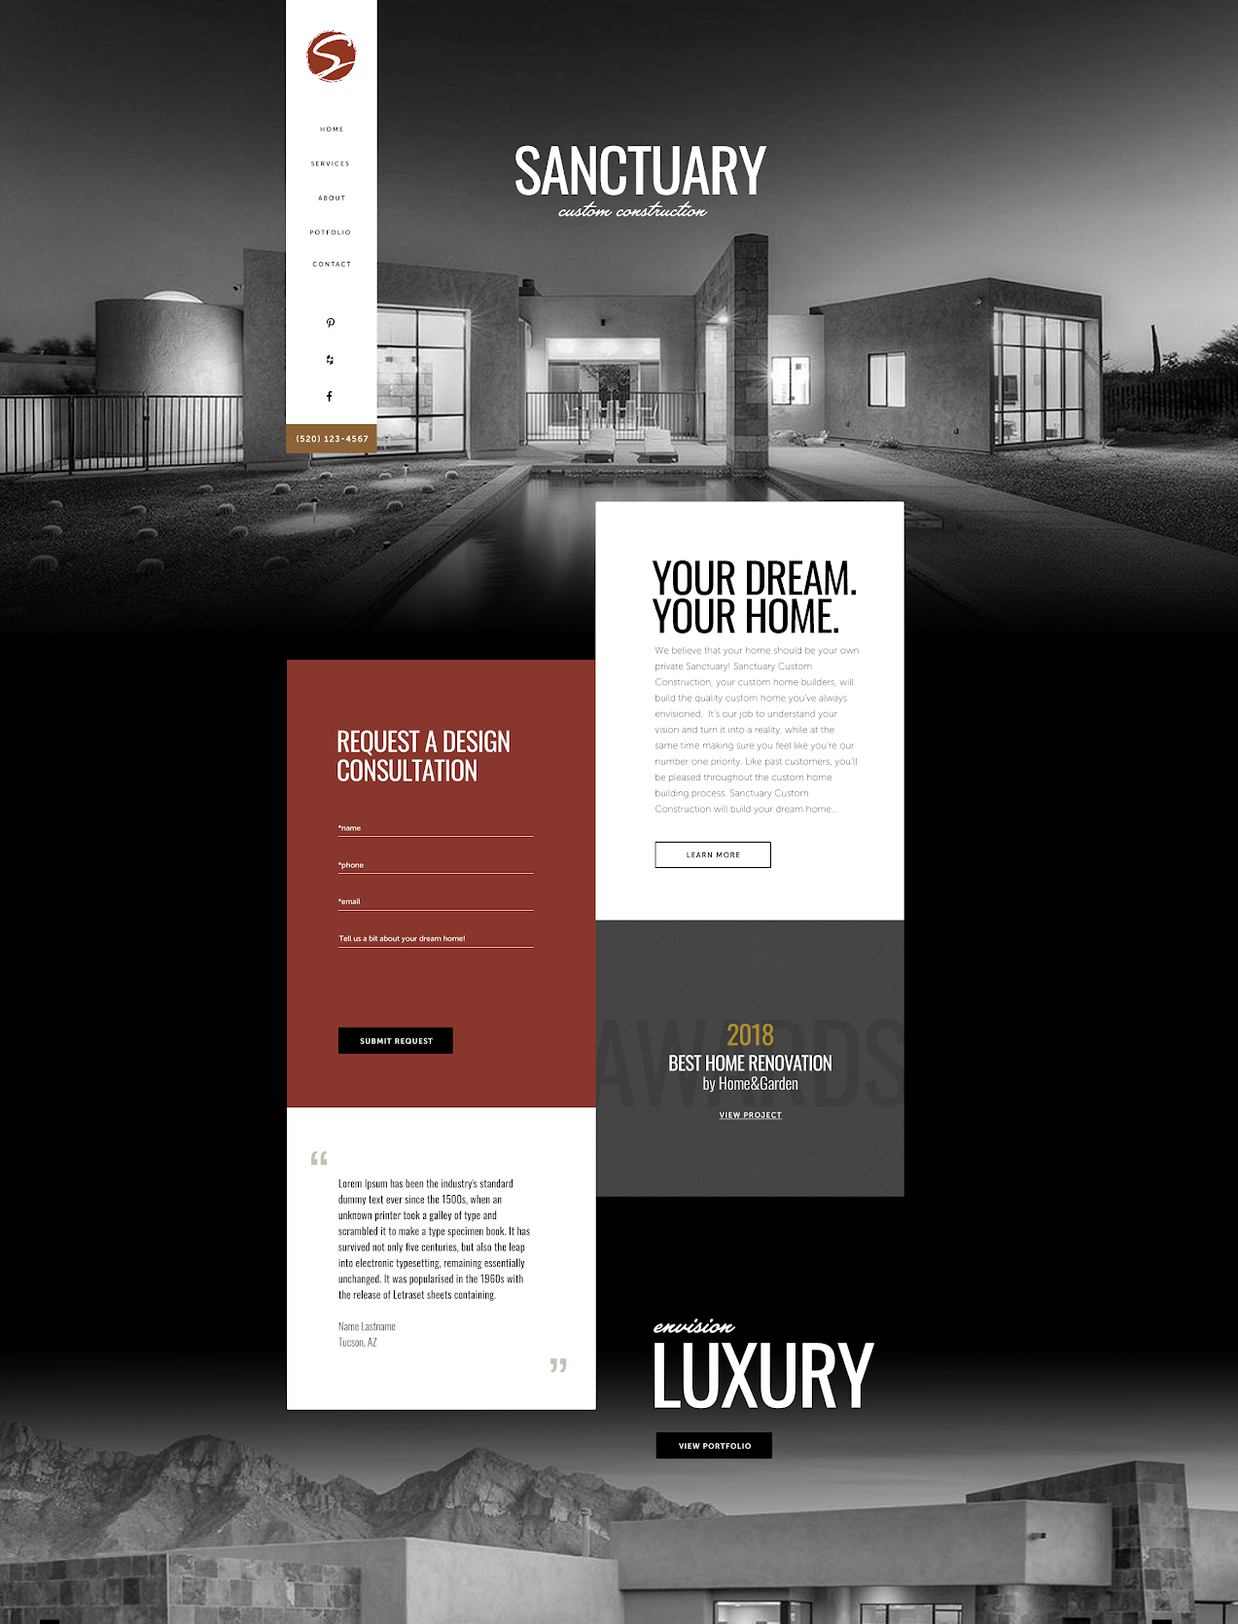
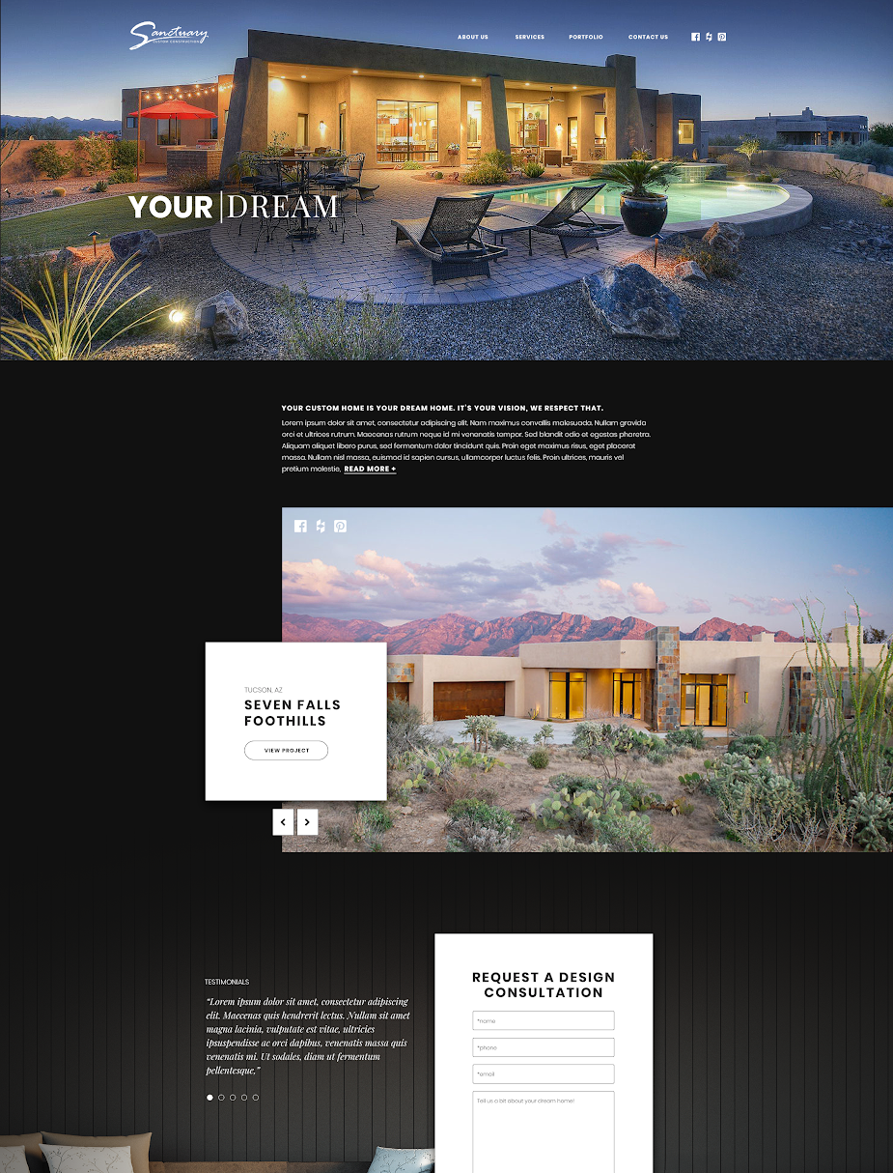
PREMIER DESIGN
Sanctuary Custom Homes
1
PREMIER
HOMEPAGE
DESIGN
KICKOFF
DESIGN
BUILD
CONTENT
2
LAUNCH
DIGITAL
MARKETING

Slide 15

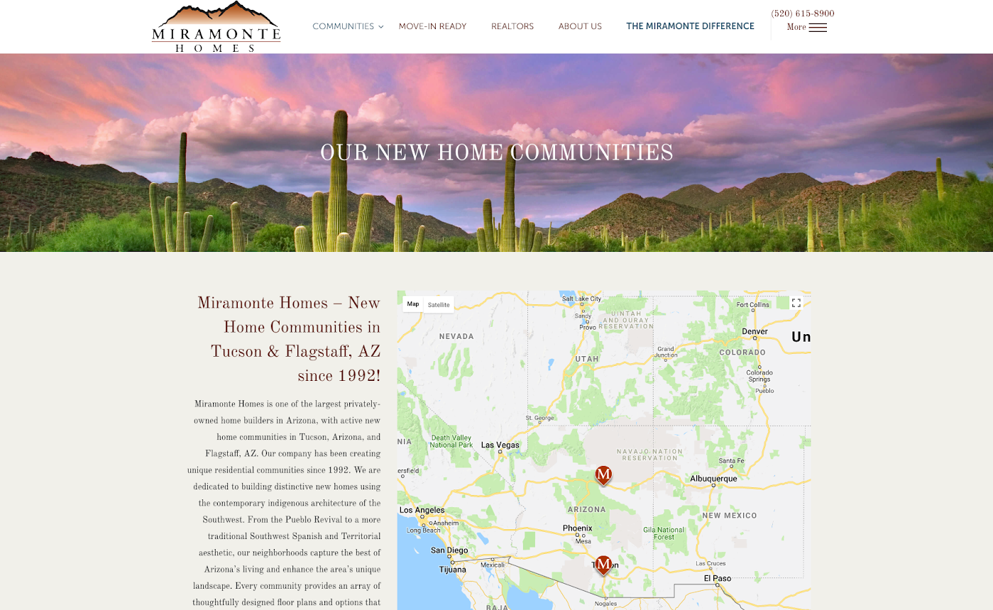

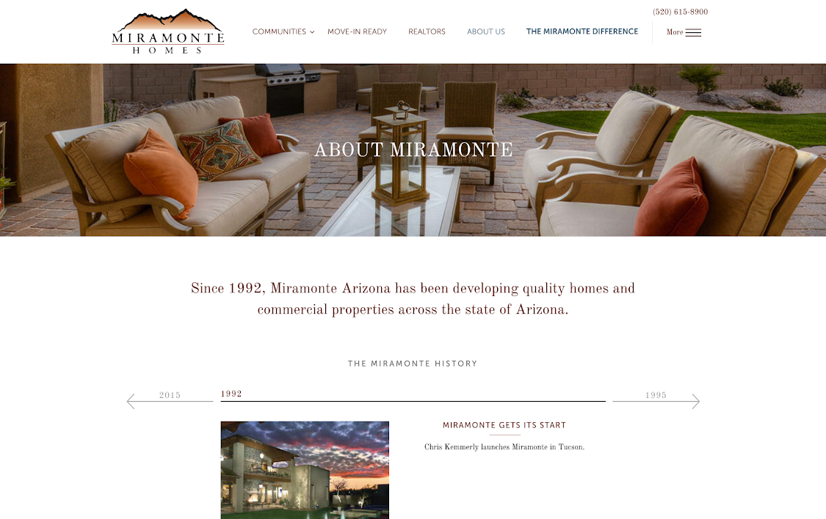

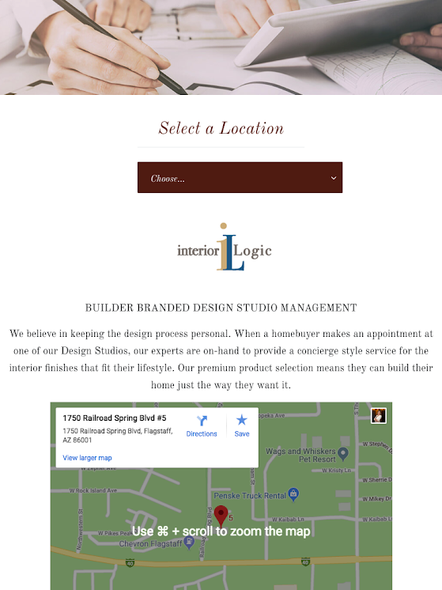
INTERIOR LAYOUTS
PREMIER
INTERIOR
PAGES
UNIQUE PAGE STRUCTURES THAT SUPPORT PAGE GOALS
CONSULTATIVE PAGE PLANNING
CLIENT-SPECIFIC CONVERSION STRATEGIES
KICKOFF
DESIGN
BUILD
CONTENT
LAUNCH
DIGITAL
MARKETING
Notes:
This is a step I feel like too many web companies skip or gloss over. I’m sure you’ve seen those sites where the homepage is nice, but as soon as you click on any links you get a really basic page with a paragraph of text and maybe a picture slapped in there with no regard to guiding somebody through the site. At Anchor Wave we like to really focus in on some of the important pages and ask, “what is the goal for this one page?”. “What does somebody need to understand after reading it and what is the next step we’d like them to take”. Remember the homepage is like the front of a magazine. It’s job is to excite someone and want to make them explore content like you thumbing to page 67 to see an article. Once they get there its that pages job to get you to take action. That’s why this step is so important.

Slide 16
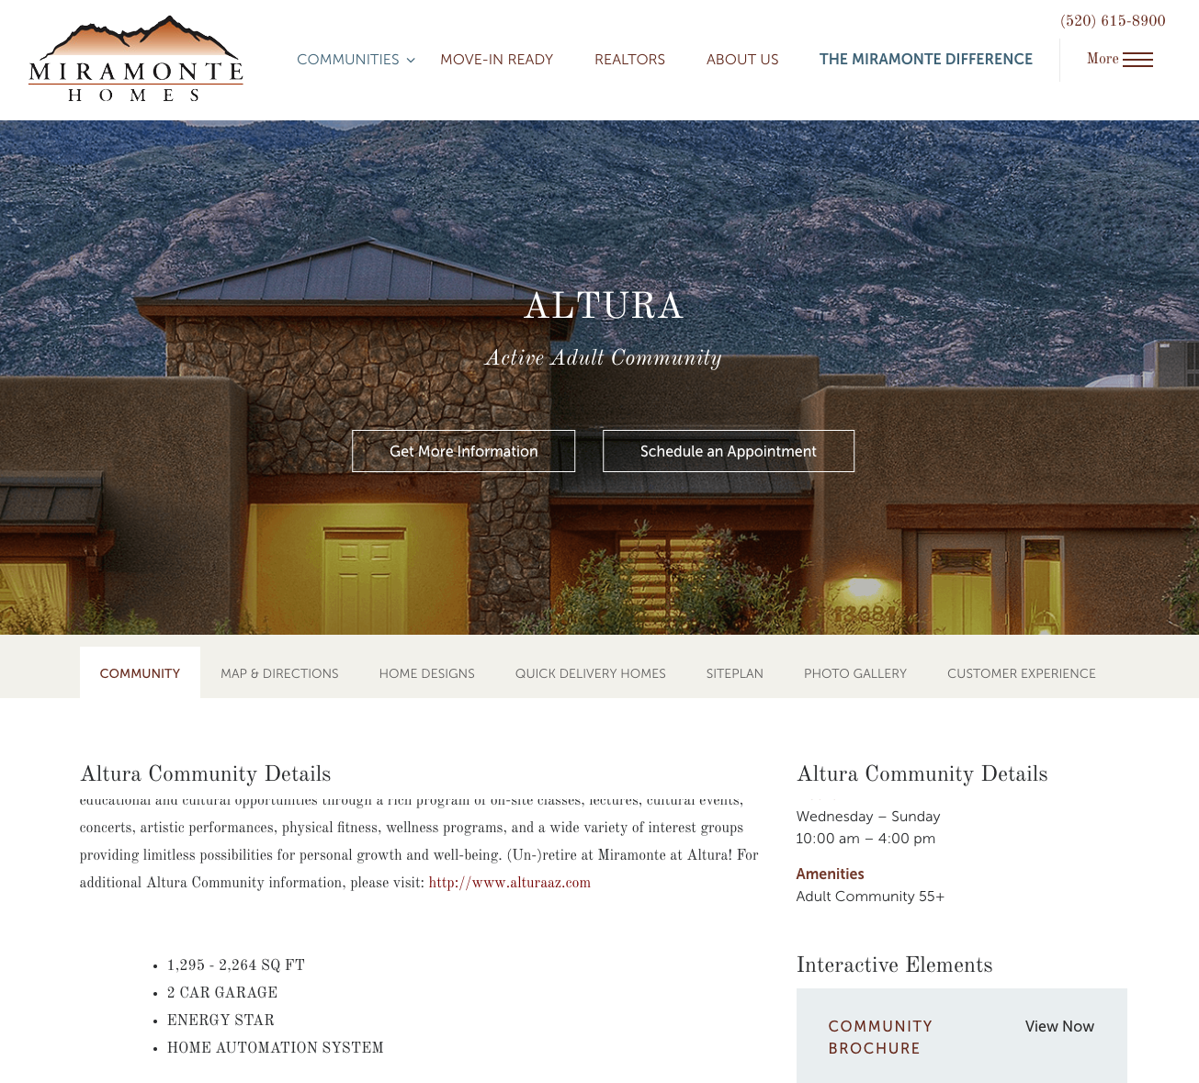
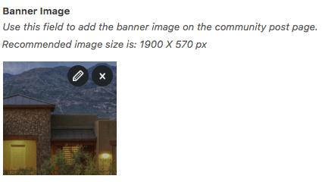
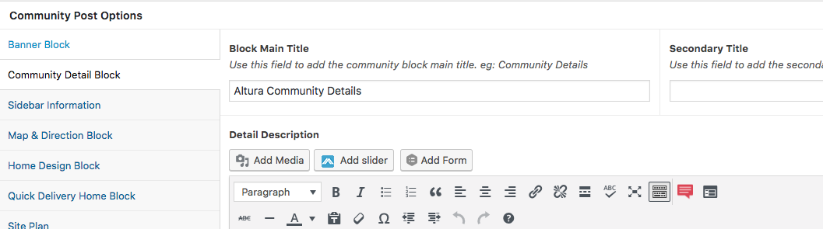
custom fields allow for easy content management
ADMIN TOOLS
Throughout the design process, we will identify what content you will need to change and how often.
We custom code the content so that it is as easy as possible to make changes. Make edits without seeing or editing any HTML or CSS.
PREMIER
CUSTOM
FIELDS
KICKOFF
DESIGN
BUILD
CONTENT
LAUNCH
DIGITAL
MARKETING
Notes:
Your site will be built on a content management system that allows your team to make changes to the website. After the site is built we’ll invite you in for training so you can learn the ins and outs of the system. We’ll also allow for additional training for 30 days that way you are able to get a good handle on the system. Some of our clients love the ability to make changes to the site themselves. Others would rather never touch the site and rely on our team for ongoing changes. We are happy to work with you in either capacity.

Slide 17

WHAT MAKES OUR CUSTOM SITES BETTER
THAN OUR COMPETITORS?
Quality of our custom designs. Browse our library to see how our designs are well above our competitors.
Strategic page planning. Our process is very hands on with 1:1 review of your company goals. We combine your personalized buyer personas and web research with our conversion tools and knowledge so that your site is not only attractive but successful.
We plan and design every page — not just the homepage. Some competitors are saving cost by not giving the interior pages the attention they deserve.
You influence & approve design. We offer guidance to our clients so that their site is easy to use and converts viewers, but the design course is directed and completed for the client. Programming is not completed until the client is satisfied and approves every aspect of the design.
Licensing to our image library is included.
Common features are included. We don’t expect our clients to know what they need when it comes to basic functionality. Blogs, contact forms, galleries, sliders, and Google Analytics are commonly add-ons at other firms.

Slide 18
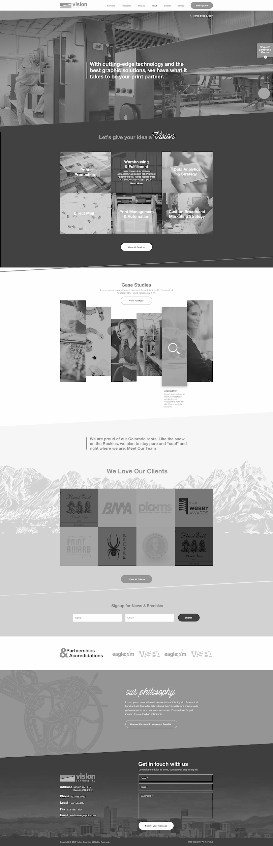
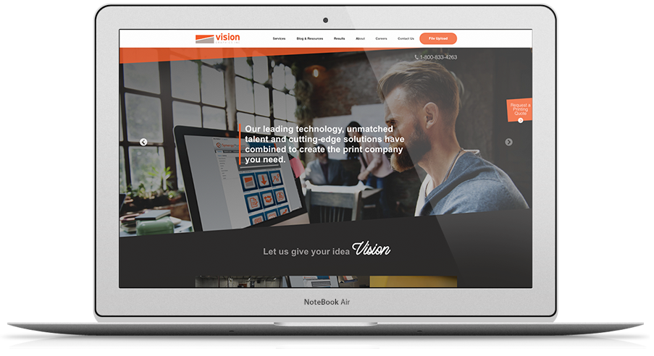


PREMIER DESIGN SUCCESS
Vision Graphics
Notes:
After the kickoff and website research meetings our project coordinator will create a web design spec that summarizes everything we’ve learned up to that point. She’ll hand it off to the designers and each will create an initial mockup of the homepage. This is probably my favorite part of the process because it’s the first chance you get to see what your site will look like. We like to have 2 designs because you’ll usually just gravitate to one of the designs presented. Sometimes you might like elements of both and we can try to merge the two together. Once we are settled in to what the homepage of your site looks like then we’ll start mocking up some of the interior pages.

Slide 19
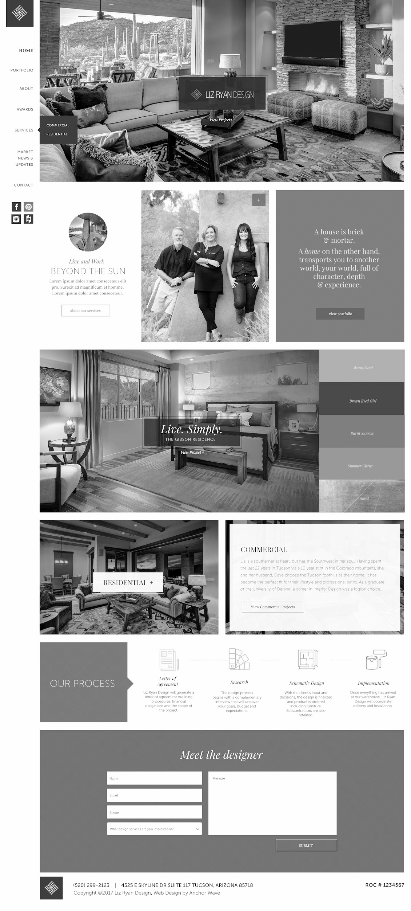
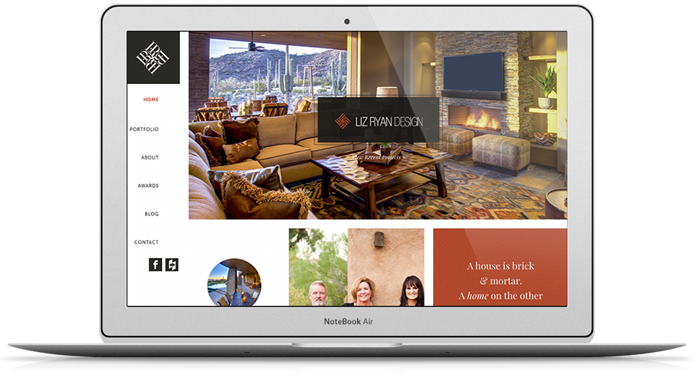
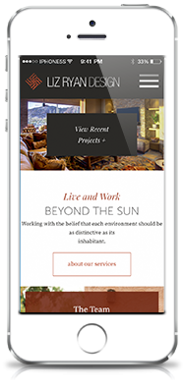
PREMIER DESIGN SUCCESS
Liz Ryan Design
DESIGN
Notes:
After the kickoff and website research meetings our project coordinator will create a web design spec that summarizes everything we’ve learned up to that point. She’ll hand it off to the designers and each will create an initial mockup of the homepage. This is probably my favorite part of the process because it’s the first chance you get to see what your site will look like. We like to have 2 designs because you’ll usually just gravitate to one of the designs presented. Sometimes you might like elements of both and we can try to merge the two together. Once we are settled in to what the homepage of your site looks like then we’ll start mocking up some of the interior pages.

Slide 20
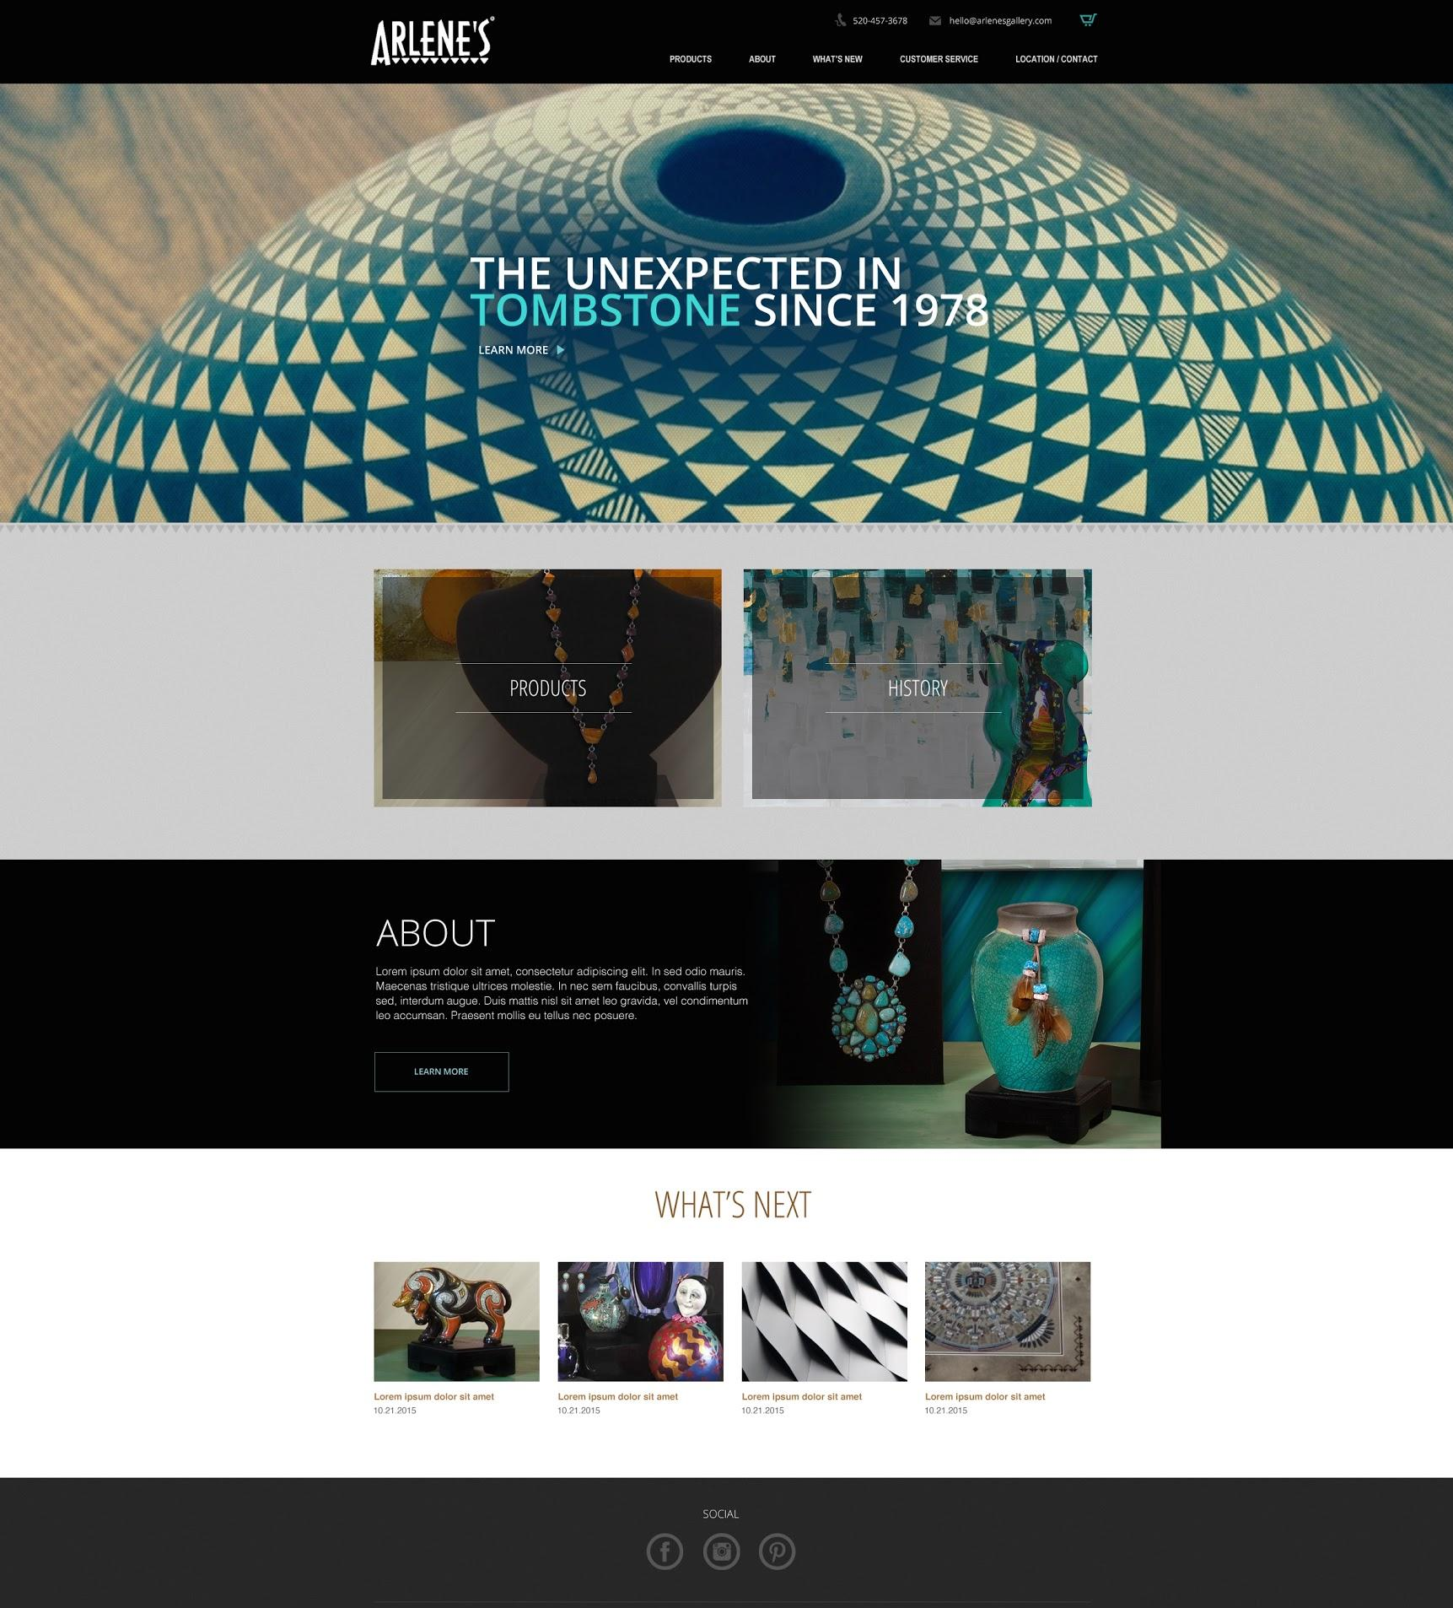
“Anchorwave understood what I was looking for in a website from the start. Their design team was very responsive to help guide me through what our website could look like and gave me some great ideas and options. Anchorwave gave me one point of contact, a project manager, for the whole process making it very easy to communicate and make quick progress during the build. I would recommend Anchorwave for anyone who wants to have a great looking website that they can be proud of. Thanks to Jill and the entire Anchorwave team!”
Arlene’s Gallery
DESIGN
Notes:
After the kickoff and website research meetings our project coordinator will create a web design spec that summarizes everything we’ve learned up to that point. She’ll hand it off to the designers and each will create an initial mockup of the homepage. This is probably my favorite part of the process because it’s the first chance you get to see what your site will look like. We like to have 2 designs because you’ll usually just gravitate to one of the designs presented. Sometimes you might like elements of both and we can try to merge the two together. Once we are settled in to what the homepage of your site looks like then we’ll start mocking up some of the interior pages.

Slide 21
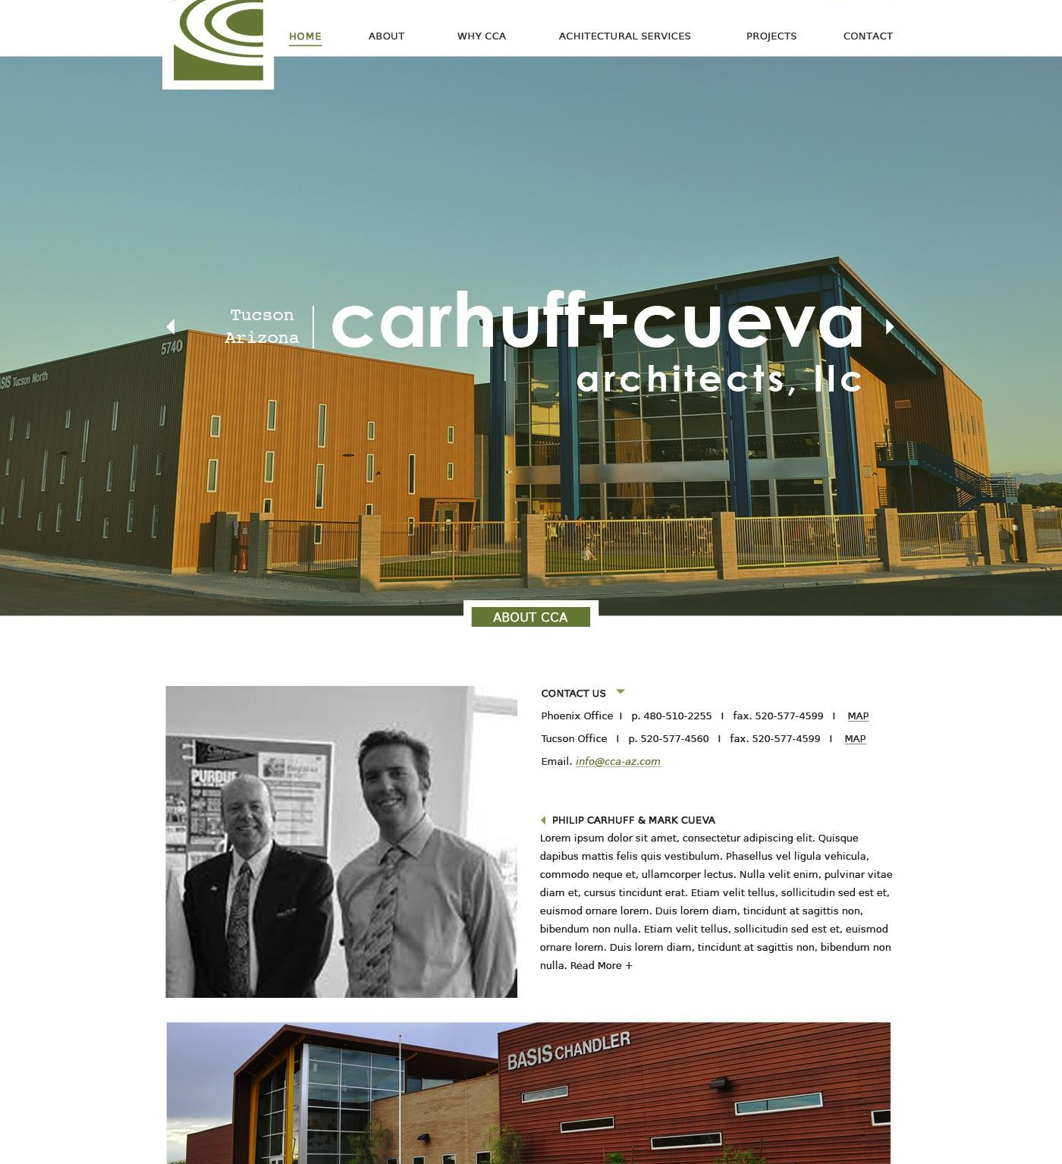
“Trying to figure out what our website could be could have been a very overwhelming experience. However, Anchorwave made it very easy and enjoyable. It was great figuring out what our website was going to look like. Getting different options from Anchorwave really helped get a good idea of the final product.
I really appreciate how fluid and easy to navigate the webpage is. It provides you the important information upon first visiting the site.”
Carhuff & Cueva Architecture
Notes:
After the kickoff and website research meetings our project coordinator will create a web design spec that summarizes everything we’ve learned up to that point. She’ll hand it off to the designers and each will create an initial mockup of the homepage. This is probably my favorite part of the process because it’s the first chance you get to see what your site will look like. We like to have 2 designs because you’ll usually just gravitate to one of the designs presented. Sometimes you might like elements of both and we can try to merge the two together. Once we are settled in to what the homepage of your site looks like then we’ll start mocking up some of the interior pages.

Slide 22
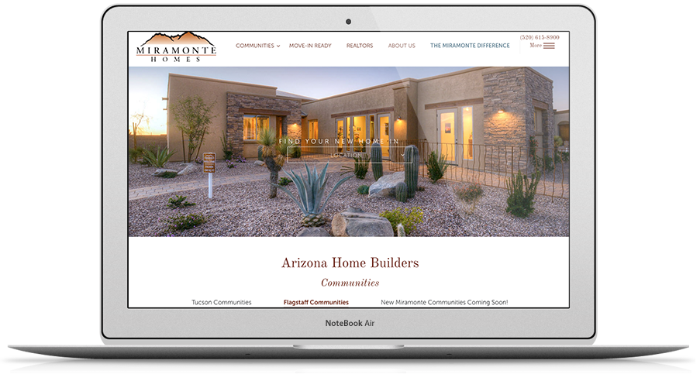
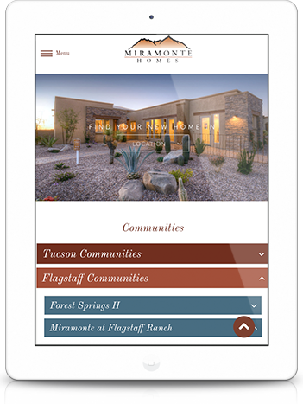

The Anchor Wave Standard
MOBILE RESPONSIVE
DESIGN
Notes:
Once we have design sign off we’ll move into the build stage of the project. Our developers will build out the website on a test server. That way you’ll be able to review it prior to any of your customers seeing it live. During this stage we are doing our best to ensure that your site will look good on various devices from desktop to tablet to mobile. We are also doing browser compatibility testing to make sure it looks fine on a pc vs a mac

Slide 23






The Anchor Wave Standard
PRE-LAUNCH
& LAUNCH
APPROVAL &
TRAINING
BROWSER TESTING
REDIRECTS
GOOGLE ANALYTICS
Notes:
Once we’ve got final approval from you we’ll enter our pre and post launch process. We have pre-defined checklists that have been created in building over 1,100 sites. Any time an issue has come up that we didn’t predict we add it to this checklist so it will never happen again. As a result, you are able to leverage all of that experience to ensure a smooth launch.

Slide 24




SEO READY
The Anchor Wave Standard
Search Engine Indexed, Analytics Account Added
Properly Coded for Search: H1s and Page Titles
Best Practices
in Mobile
Notes:
Another thing that we are ensuring during the build process is that the site is SEO ready. This means that all of the technical components Google is looking for are present which will improve your chances of being found in Google search.

Slide 25


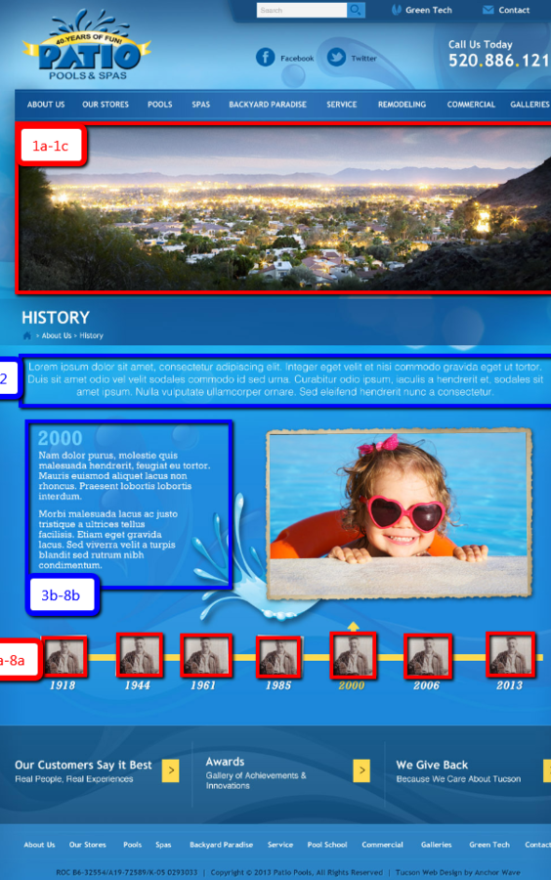



THE ANCHOR WAVE STANDARD
RESOURCES & TOOLS
Always Included:
Content Outlines
& Helpful Tips
Always Included:
Stock Images
Available:
Copywriting Services
Available:
Professional
Photography
Notes:
Next we move into the content phase. This is where we will need some help from you. Don’t worry we’ll never ask you for content without guidance. We’ll never say “give me the content for the about us page”. We would say something like “give me 2 paragraphs about the history of the company, 4 bullet points about what makes you different, a summary of your mission/values and a picture of your leadership team” We know asking in that way makes it a lot easier for you to put that together quickly or even delegate pieces of that to other people on your team to expedite the process. I have to be honest and tell you that this is typically the point in the project where things can slow down. Up until now we’ve taken the lead on everything and shared designs and built pages for you to provide feedback on in meetings....that’s the fun part. This is really the first point in the process where we need things from you before we can move forward. I would encourage you to start thinking about this early and putting things together as early as possible. If you think that putting copy together will be a challenge we offer copywriting services however that has not been included in the investment for this proposal.

Slide 26








SSL (Security Certificate)
WordPress & Plugin Updates
Server-wide Firewall
Available
Security Scanning
HEALTHY HOSTING
Available Speed Tools
“Healthy Neighbors”
Site Backups with Retention
Notes:
SSL (Security Certificate) - $100 Value
SSLs are required for any sites requesting information or online payments. Google also continues to reward sites with SSLs.
WordPress & Plugin Updates - $2100 Value
WordPress updates are important for keeping your site and the server environment healthy by updating security to avoid hacks.
Server-wide Firewall - $1089 Value
Network traffic on our server is monitored and protected by this security system to quickly detect any abnormalities.
Security Scanning
As an additional layer of security, recurring scans are running in the background of our server and your website to identify potential threats.
Faster Tech Service
Our technical support team works in a stable, secure environment where they can quickly troubleshoot issues.For websites on Anchor Wave servers, it takes a fraction of the time to resolve website hacks and remove malware. This means what could be a $390+ job, can be resolved for only $130+.
Available Speed Tools
Special assessment tools are now available to help us evaluate and improve website speed.
Healthy “Neighbors”
You are hosting on a server with other HEALTHY SITES in an environment that is held to the same security standards, meaning you are less likely to get infected by unhealthy sites.
Site Backups with Retention
Daily backups of your site.

Slide 27


SSL (Security Certificate)
Available
WordPress & Plugin Updates
Healthy
Hosting
+
WordPress
Warranty
Server-wide Firewall
Unlimited Technical
Support
+
Security Scanning
Available Speed Tools
Unlimited Content Management Training
“Healthy Neighbors”
Site Backups with Retention

Slide 28



WHICH OPTION IS BEST FOR ME?
BASED ON YOUR WISHLIST
A timeline less than 8 weeks
Lots of advice from expert
Photo Gallery
Custom Design & Programming
Accessibility

Slide 29
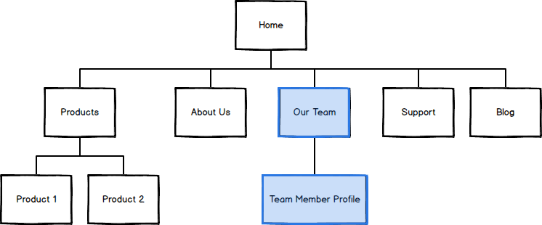
Website Outline - Option A
KEY FACTORS
Number of Pages | 7
Number of Page Templates | 5
CPTs | Team Members (Standard)
Site Content | Provided by Client (Copywriting Services Available)
Notes:
<go page by page, mention anything specific from the ID that demonstrates that you were listening and how that influenced this outline> For example. “Here is the about us section, as you can see I added two pages underneath...one for key leadership and one for history. I included these pages because last time we met you mentioned that your leadership team is really well known in your industry and is a big reason prospects decide to work with you. You also spoke at length about how you’ve been in business for 32 years and that gives you a real edge on your competitors. Since those pieces are so important I want to make sure we have spots reserved so we can really emphasize them and make it easy for prospects to notice them” <the more you can do this the easier it is to sell larger outlines. Its easy to cut pages, but if you can give the logic behind why having them is based on their goals, they will have a lot harder time cutting them as it means they are in a way cutting that goal out of the picture.>
This is a new tool lucid charts that you’ll use to create these now. That way you won’t have to have multiple pages for a single outline.

Slide 30
Summary of Investment
Exhibit A - Option 1 Premier Site
DESCRIPTION | PREMIER | NOTES
Homepage Design Concepts | $2,650 | 2 Custom Design Concepts resulting from Web Research, Consumer Profiles and Design Consultation from your PC
Interior Page Designs | $1,625 | Design/Layout for 5 interior pages
Page Construction & Content Addition | $5,250 | Construction of up to 7 pages
Launch | $520 | Launching of the site onto our server or a 3rd party server. Includes redirects, pre and post launch checklist items. This does not include hosting cost or transfer fees.
Simple CPT: Team Members | $390 | 1 unique view, 2-5 Custom Fields, No special functionality. Client responsible for adding content.
WordPress Warranty | 30 Days | 30 days included on sites that host with us. Backup, tech support, training & WP Updates.
Total Investment | $10,710 | Phased payments: 50% due on signing, 40% due before build, 10% due before launch.
Project Hour Budget | 82 hours | Your project budget is a working estimate. We offer a 10% buffer for all projects. If the project goes beyond the hourly estimate by more than 10%, the project moves to hourly billing.
Initial to Accept | ___________

Slide 31
Custom Post Types (CPTs)
Exhibit A - Part 2
PREMIER SITE OPTIONS |  | DETAILS
Simple CPT (Testimonials, Clients) | $390 | 1 unique view, 2-5 Custom Fields, No special functionality. Client responsible for adding content.
Standard CPT (Team Profiles) | $3510 | 2-3 unique views, 6-10 Custom Fields, No special functionality. Client responsible for adding content.
Complex CPT (Portfolio/Projects) | $6244 | 3+ unique views, 11+ Custom Fields, advanced functionality like Categories/Filters, Multi-Level CPTs, Search Functionality. Client responsible for adding content.
Content Entry by Anchor Wave | $130/hour

Slide 32
Recommended Services
Exhibit A - Part 2
DESCRIPTION |  | NOTES | INITIAL TO ADD
Mobile Responsive Design | Included | Optimized for use on Mobile and Tablet devices | Included
Content Management System | Included | Update, maintain the website through Page Builder | Included
Google Analytics | Included | Website Statistics | Included
Accessibility (Web For All) | $______ | Make your site accessible to users with disabilities. Price is a working estimate based on the number of forms, images and special functionality.
Content Copywriting | $80/page | Professional copywriter based on your direction
Custom Photography | $350/hour on site | Headshots, products, buildings, office settings

Slide 33
Support Services
Exhibit A - Part 3
DESCRIPTION |  | NOTES | INITIAL TO ADD
WordPress Warranty + Healthy Hosting | $124/month $1364/year | Hosting including daily backups, WP updates, and an SSL. Plus unlimited tech support, and unlimited content management training.
Healthy Hosting | $40/month $460/year | Hosting including daily backups, critical WP updates, and an SSL. If you decide to host with a 3rd party host, there will be a one-time $200 transfer fee.
Email Hosting | $5/mailbox/mo. | 25GB Storage, Webmail Included
Domain Name Registration | $30/year
Hourly Rate | $130/hour | Future updates and services as needed

Slide 34
View your onboarding docs here.

Slide 35
Enrollment Form
Page 1
WEB SERVICE CONTACT
Name
Email
Phone
Cell
[ ] Accounting Contact is the same as above. Otherwise please fill out below.
ACCOUNTING CONTACT
Name
Email
CC Email
Phone
COMPANY INFORMATION
Full Company Name
Address Line 1
Address Line 2
City
State
Zip Code
[ ] I authorize Anchor Wave to charge the above card for recurring invoices
Signature
Date

Slide 36

Thank You
Next Steps
Schedule Kickoff With Project Coordinator
Identify Site Development Priority
Complete Exhibit A & Enrollment Form
1.
2.
3.

